Slide 1
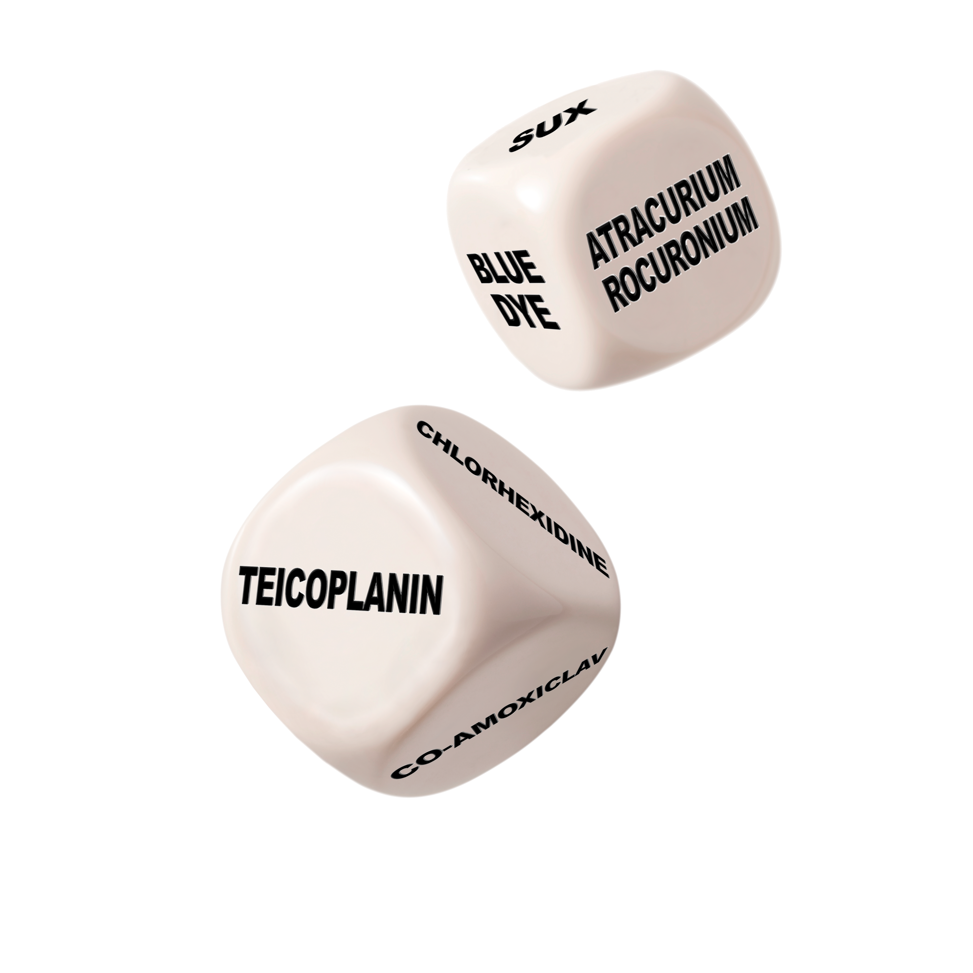
Anaesthesia, Surgery and Life-Threatening Allergic Reactions The 6th National Audit Project: Perioperative Anaphylaxis
Slide set prepared by
Prof Nigel Harper, Clinical Lead NAP6 with thanks to all presenters at the NAP6 Launch meeting May 2018
V1 June 2018

Slide 2
What we already know
Perioperative anaphylaxis is an uncommon but hazardous accompaniment of anaesthesia and surgery
It is usually an allergic reaction to one of the many drugs administered
It can occur suddenly in any patient, regardless of allergy history or previous uneventful anaesthesia
Most previous studies have implicated muscle relaxant drugs (NMBAs) as the most common cause
Published guidelines exist on management and investigation but levels of compliance are unknown

Slide 3
Aims of NAP6
What proportion of cases of suspected perioperative anaphylaxis are referred and investigated?
How many are proven to be anaphylaxis and what are the culprits?
How well does immediate management, referral and investigation match published guidelines?
Is there a correlation between immediate management and outcomes?

Slide 4
5 phases of NAP6
Baseline survey of anaesthetists perspectives/experiences
Baseline survey of allergy clinic organisation
Baseline organisational survey*
Year-long anonymised case registry Numerator
Activity/Allergen Survey Denominator
*See full report for details http://www.nationalauditprojects.org.uk/NAP6Report

Slide 5
Baseline survey of anaesthetists’ perspectives/experiences
11,104 (77%) anaesthetists in 341(96%) hospitals responded
1734 cases* of suspected perioperative anaphylaxis in 2014-15: 2% fatal
49% of suspected cases confirmed by allergy clinic
76% had career experience of perioperative anaphylaxis
Median of 2 cases of anaphylaxis per respondent ≈ 1 every 7.25 years of practice
4% reported a death ≈ 1 every 311 years of practice
* Where the respondent was the primary anaesthetist

Slide 6
Baseline survey of anaesthetists’ perspectives/experiences
Antibiotics used in 57.2% of cases (2.5 million administrations, often combinations)
In 25% of teicoplanin or vancomycin uses, allergy history influenced drug choice
Suxamethonium and penicillins were avoided by a higher proportion of respondents than events attributed to these drugs; the converse was true for atracurium and teicoplanin
Of the responding anaesthetists:
87% had immediate access to guidelines
37% had ‘anaphylaxis treatment pack’ available
82% knew where to refer the patient for investigation
35% had a departmental lead for perioperative anaphylaxis

Slide 7
Baseline survey of allergy clinic organisation
Online questionnaire distributed to providers of allergy services in the UK in 2016
Over 1200 patients were investigated in 44 centres annually
21 adult centres saw >20 patient per year, twelve <20 adults and eleven only children
Variation in workload, waiting times, access, staffing, and diagnostic approach was noted. Geographical variation was marked
Paediatric centres reported the longest routine waiting times (most wait >13 weeks) in contrast to adult centres (most <12 weeks).
Service leads are allergists/immunologists in 91% and anaesthetists in 7%

Slide 8
Where are the specialist allergy clinics?
Potentially important differences were seen in:
Testing repertoire: 10/44 (23%) lacked BSACI-compliant NMBA ‘panels’
17/44 (39%) lacked a NAP6 defined minimum NMBA panel
19/44 (43%) failed to screen all cases for chlorhexidine
21/44 (48%) failed to screen all cases for latex
26/44 (59%) had specialist nurses
18/44 (41%) clinics included an anaesthetist
18/44 (41%) gave immediate information to patients in clinic, and 5/44 (11%) on support groups

Slide 9
Case Reporting Phase
Provided numerator data for the project
Local Coordinator in every NHS Hospital
Grade 3 – 5 anonymised cases reported on line
266 cases reviewed by a multidisciplinary panel
Part A
Patient demographics
Drugs administered
Features of the reaction
Immediate management
Referral for investigation
Initial outcomes
Part B
Investigations performed and results
Diagnosis
Communication with patient
Outcomes
Reporting

Slide 10
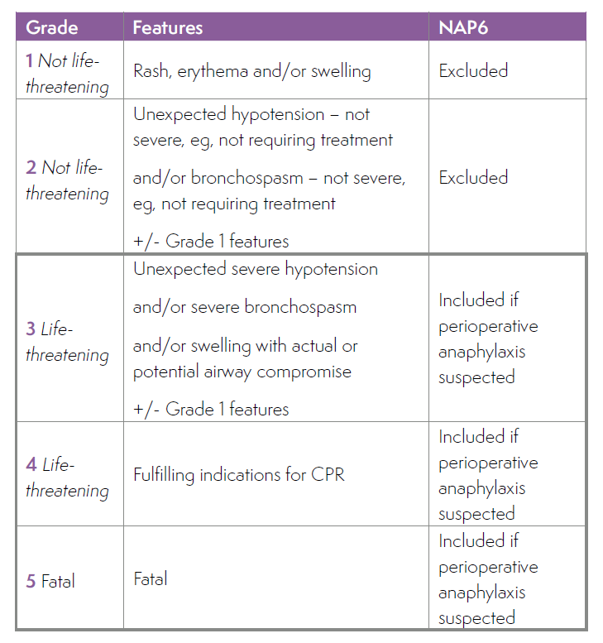
Inclusion
Perioperative
any case involving an anaesthetist and a procedure
From time of first drug administration (including premed) to post-procedure transfer to ward or critical care

Slide 11
Review Process
Multidisciplinary panel met monthly
Anonymised to location, individuals and hospital
Review in triplicate to minimise bias
Guidelines for clinical management and investigation used to attribute quality measures (‘good’/’good and poor’/poor’)
RC(UK) 2016: Management of Anaphylaxis
European Resuscitation Council 2015: CPR
AAGBI 2009: Management of Suspected Anaphylaxis
British Society for Allergy and Clinical Immunology (BSACI) 2010: Guidelines on Investigation
NICE Clinical Guidelines 134 and 183
Panel identified culprit agent (where possible), probability and mechanism
Assessed outcomes and severity of adverse sequelae

Slide 12
Key Findings: Clinical features
Overall incidence estimated at 1:10,000 anaesthetics
Severe hypotension was present in all cases
Anaphylaxis presented within 10 minutes of exposure to the culprit agent in 83% of cases
Anaphylaxis caused by chlorhexidine and Patent Blue dye had a slower onset
Skin signs were uncommon in the more severe cases of anaphylaxis, sometimes only occurring after resuscitation
The first clinical feature with suxamethonium-anaphylaxis was usually bronchospasm
Perioperative anaphylaxis can present as isolated organ system involvement

Slide 13
Key Findings: Clinical management
All patients were resuscitated by an anaesthetist of appropriate grade, and recognition of a critical event was prompt
When cardiac compressions were indicated there was delay starting them in more than half of cases
Published evidence and expert advice strongly suggests that cardiac compressions should be started immediately if the systolic blood pressure is < 50mm Hg (adults). Patients in this category were judged to be Grade 4
IV fluid administration was inadequate in one in five cases. Median (range) IV fluid volume administered (all cases):
First hour 1L (0.1-5L)
Subsequent 2 hours 1L (0.1-3L)
Hours 3 – 5 0.5L (0.1-.5L)

Slide 14
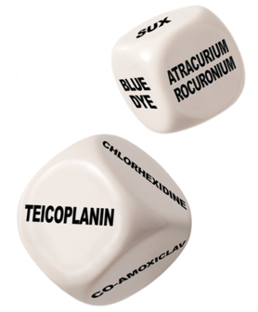
Key Findings: Trigger agents and investigations
Most common trigger agents:
1) Antibiotics 2) NMBAs 3)chlorhexidine, 4) Patent Blue dye
Highest incidence /100,000 exposures:
1) teicoplanin, 2) Patent Blue dye, 3) suxamethonium, 4) co-amoxiclav
Average clinic waiting time 101 days (up to 450 days). Only16% seen within the ideal six weeks; 23% breached the national UK 18-week target for first appointments, and 7% waited longer than six months
Clinic investigations adhered fully to AAGBI guidance in 32% and to BSACI guidance in only17%, mainly failing to test for all potential culprits and providing poor communication

Slide 15
Key Findings: Antibiotics 1
Antibiotics most common cause of perioperative anaphylaxis in UK
35% of all cases (NMBAs ≈25% of cases)
Antibiotic anaphylaxis in 5.15 per 100,000 patients /yr receiving at least one antibiotic perioperatively
3.96 per 100,000 antibiotic administrations /yr develop antibiotic anaphylaxis
Co-amoxiclav caused17.3% and teicoplanin 13.5% of the 35% total ie 89% of all cases
Perioperative anaphylaxis incidence:
Teicoplanin -16.39 per 100,000 administrations /yr, ie16-fold that of cefuroxime
Co-amoxiclav -8.64 per 100,000 administrations /yr ie 9-fold that of cefuroxime
vancomycin was 3rd and piperacillin-tazobactam 4th place - distant
Notes:
NMBAs, second leading cause, ≈25% of cases
The onset of anaphylaxis was within 5 minutes in 74% of cases, within 10 minutes in 92% and in all cases within 30 minutes
Previous history of penicillin allergy appears to be a risk factor for anaphyalxis to Teicoplanin and therefore:
This evidences the need for robust programmes to investigate and de-label, where appropriate, patients with reported history of penicillin allergy.

Slide 16
Key Findings: Antibiotics 2
Most common first clinical feature was hypotension - 42% of all antibiotic cases
presented within 5 min of exposure in 76% of cases
Two fifths of the patients with a pre-operative history of penicillin allergy reacted to teicoplanin
Allergy clinics did not identify the antibiotic culprits in 25% cases due to incomplete investigations i.e.
skin tests and drug provocation challenges
In two thirds of cases inappropriate advice on future avoidance was given by allergy clinics
Allergy clinics may be underdiagnosing antibiotic allergy, potentially placing patients at risk
Notes:
NMBAs, second leading cause, ≈25% of cases
The onset of anaphylaxis was within 5 minutes in 74% of cases, within 10 minutes in 92% and in all cases within 30 minutes
Previous history of penicillin allergy appears to be a risk factor for anaphyalxis to Teicoplanin and therefore:
This evidences the need for robust programmes to investigate and de-label, where appropriate, patients with reported history of penicillin allergy.

Slide 17
Key Findings: NMBAs
 | Cases confirmed | Proportion of UK NMBA usage | Anaphylaxis rate/100,000 uses
Suxamethonium | 14 | 11.2% | 11.1
Rocuronium | 27 | 40.6% | 5.88
Atracurium | 23 | 49.1% | 4.15
Mivacurium | 1 | 2.7% | 3.25
Vecuronium | 0 | 2.2% | –
Cisatracurium | 0 | 1.6% | –
Pancuronium | 0 | 0.6% | –
Suxamethonum clearly higher risk
Rocuronium v atracurium less clear due to wide 95% Confidence Intervals
Sux: 1 in 5, 368 – 1 in 16, 473
Roc: 1 in 11, 686 – 1 in 25, 799
Atra: 1 in 16, 069 – 1 in 38, 034

Slide 18
Key Findings: Chlorhexidine 1
Exposure route (often multiple) | Number
Skin for cannula | 10*
Skin for neuraxial blockade | 7
Skin for surgical site | 4
Coated CVC | 6
Urethral gel | 11
3rd of the “big four”culprits – 18 cases (9%)
16 males, 6 urology surgery, 3 cardiac, 3 orthopaedics
1 fatal case
Not investigated by specific IgE to chlorhexidine
Onset can be delayed but rapid for chlorhexidine coated CVCs
None where the ONLY reported exposure was skin preparation for cannulation

Slide 19
Key Findings: Chlorhexidine 2
Often not suspected (only in 28% of cases) by anaesthetist
3 potentially avoidable cases
1 reported prior chlorhexidine allergy
1 reported prior perioperative allergy that was not investigated
1 NAP6 confirmed chlorhexidine allergy case experienced subsequent anaphylaxis to chlorhexidine in 2nd procedure
Chlorhexidine coated central lines not always removed (2 of 6 CVC related cases)
Testing for chlorhexidine was frequently omitted in allergy clinics

Slide 20
Key Findings: Patent Blue dye
Fourth most common cause of perioperative anaphylaxis (14.6/100,000 administrations = higher risk than suxamethonium)
9 cases
Profound hypotension common
Desaturation was the 2nd most common presenting feature
1/3 had no skin signs
Onset >10 mins in 5 cases and >60 mins in 2 cases
2/3 required transfer to critical care
NB: Patent Blue dye can cause spurious oxygen desaturation but this should not be assumed to be the cause

Slide 21
Key Findings: Paediatrics
Annual estimated workload of 402,753 paediatric cases
11 cases: 1<5 yrs; 10 5-16 yrs (1/4 as common than in adults)
The presenting feature was bronchospasm in 2/3 of cases
Atracurium was responsible in 3 cases
Single cases of: lidocaine, suxamethonium, piperacillin/tazobactam, teicoplainin, aprotinin, cefuroxime, ibuprofen and cryoprecipitate
Antibiotic-anaphylaxis much less common in children than adults
Management judged to be good in 7 cases, good and poor in 4 and poor in 1
Only one case was reported to MHRA

Slide 22
Key Findings: Obstetrics
NAP6 Activity Survey estimated 233,886 obstetric anaesthetics PA in UK
8 cases of perioperative anaphylaxis
Incidence 3.4 per 100,000 (95% CI 1.48-6.74 per 100,000)
Culprit identified in four: suxamethonium, atracurium, chlorhexidine and ondansetron
6 cases during neuraxial anaesthesia and 2 cases during general anaesthesia
4 out of 6 patients who developed anaphylaxis during neuraxial anaesthesia complained of feeling unwell before the onset of hypotension or other clinical signs
In 4 cases (2/2 GA and 2/6 neuraxial cases) there was prompt recognition of the critical event
BUT in only one case (neuraxial anaesthesia) was the event promptly recognised as anaphylaxis
Hypotension common in obstetric cases but ‘New’ hypotension may be a sign of anaphylaxis
Phenylephrine the most-used vasopressor but there is no contra-indication to giving adrenaline in obstetric patients

Slide 23
Key Findings: Outcomes
Of the 266 cases reviewed, 40 patients experienced cardiac arrest and 10 patients died
More than half of patients required admission to critical care (70% for Level 3 care)
Poor outcomes were associated with increased age, ASA grade, obesity, beta-blocker, and/or ACE inhibitor medication
Adverse sequelae (104) included anxiety, mood and memory changes, alteration in coordination, mobility or PTSD-like symptoms
A small number of patients experienced a myocardial infarction, acute kidney injury or new shortness of breath
Fewer than a quarter of cases were reported to MHRA

Slide 24
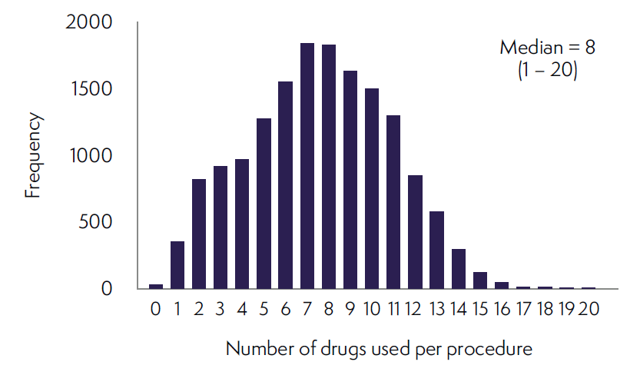
Activity/Allergen Survey
Provided denominator data
342 hospital sites reported
16,205 case report forms submitted via Local Coordinators
Scaled-up from 2 day survey to annual figures
Annual caseload = 3,126,067 anaesthetics: 77% GAs
58.7% of patients were female
Median 8 drugs given during anaesthesia

Slide 25
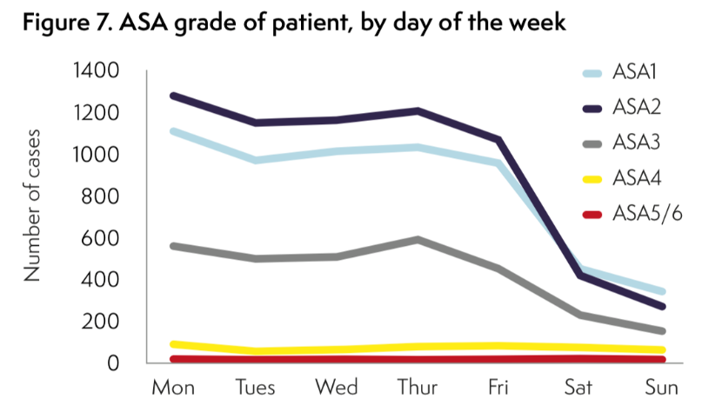
Activity/Allergen Survey: Workload
% of overall weekend workload attributed to specialties:
Orthopaedics/Trauma 23.4%
Obstetrics 20.4%
General surgery 17.2%
Senior involvement, including higher risk cases at the weekend is high but falls through Saturday (89%) and Sunday (65%)
Obstetric anaesthesia care is evenly distributed through the week and is associated with the lowest levels of senior anaesthetic involvement (69%), especially at weekends (45%)

Slide 26
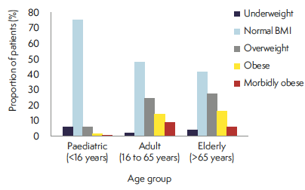
Activity/Allergen Survey: Increasing obesity

Slide 27
Activity/Allergen Survey: Induction and maintenance
Induction Drug | Estimated annual exposure | % of cases having at least 1 agent
At least 1 used | 2,552,896 | 100.0%
Propofol | 2,290,723 | 89.7%
Thiopental | 42,159 | 1.7%
Etomidate | 7,059 | 0.3%
Midazolam | 297,076 | 11.6%
Ketamine | 38,826 | 1.5%
Sevoflurane | 325,902 | 12.8%
Other volatile agent | 32,551 | 1.3%
Other induction agents | 30,590 | 1.2%
Maintenance

Slide 28
Activity/Allergen Survey: NMBAs and reversal
Drug | Estimated annual exposure | % of all GAs | % of NMBA use
At least 1 NMBA used | 1,129,478 | 47.2% | 100.0%
Suxamethonium | 126,086 | 5.3% | 11.2%
Atracurium | 554,543 | 23.2% | 49.1%
Cisatracurium | 18,629 | 0.8% | 1.6%
Mivacurium | 30,786 | 1.3% | 2.7%
Rocuronium | 459,047 | 19.2% | 40.6%
Vecuronium | 24,315 | 1.0% | 2.2%
Pancuronium | 7,059 | 0.3% | 0.6%
88.8% received a non-depolariser only, 4% sux only and 7.2% both sux and non-depolariser
Neuromuscular blockade was reversed in 62.5%
Sugammadex administered in 5.7% (4-fold increase since 2013)

Slide 29
Activity/Allergen Survey: Antibiotics
Used in 57.2% of all cases
Estimated annual administrations: 1,787,360
Gentamicin: 19.7% 616,899
Co-amoxiclav: 17.0% 535,580
Cefuroxime: 13.6% 424,143

Slide 30
Activity/Allergen Survey: Chlorhexidine and Misc
Chlorhexidine
Miscellaneous drugs/substances
Chlorhexidine exposure | Number exposed in activity survey | Estimated annual exposure | % of all cases | % of all cases exposed | % of all chlorhexidine exposure (Σ of all; total > total no of cases)
Exposure - at least 1 route | 11,722 | 2,298,567 | 73.5% | - | -
Coated/impregnated CVC | 93 | 18,236 | 0.6% | 0.8% | 0.6%
Urethral | 532 | 104,320 | 3.3% | 4.5% | 3.3%
Skin Prep - anaesthetist | 8,232 | 1,614,213 | 51.6% | 70.2% | 50.9%
Skin Prep - surgeon | 7,120 | 1,396,161 | 44.7% | 60.7% | 44.0%
Surgical irrigation | 95 | 18,629 | 0.6% | 0.8% | 0.6%
Other | 101 | 19,805 | 0.6% | 0.9% | 0.6%
Drug/substance | Number exposed in activity survey | Estimated annual exposure | % of all cases
Patent blue dye | 315 | 61,768 | 2.0%
Methylene blue dye | 139 | 27,257 | 0.9%
Bone cement | 407 | 79,809 | 2.6%
X-Ray contrast | 274 | 53,729 | 1.7%
Chlorhexidine exposure probably underestimated
Notes:
Unknown – 0.9%
No exposure reported – 23.6%
Chlorhexidine
Widely used antiseptic - ubiquitous
Increasingly reported as an emerging cause of allergy and perioperative anaphylaxis in particular
Use appears to be under-recognised in the healthcare sector
Potential to cause allergic reactions appears under-estimated by HCWs
National guidelines (e.g. NICE CG 74) recommend use of CHG to prevent surgical site infections and many local hospital guidelines advocate the use of CHG prior to cannulation
We suspect that our data may reflect under-reporting due to nder-recognition of CHG exposure – e.g. due to lack of awareness of its presence in many antiseptic alcohol wipes, urethal lubricants and CVCs

Slide 31
Activity/Allergen Survey: IV colloids, blood products and latex
 | Estimated annual exposure | % of all cases
At least 1 IV colloid/blood product used | 130,988 | 4.2%
Gelatin or gelatin-containing | 52,160 | 1.7%
Starch or starch-containing | 5,098 | 0.2%
Albumin (any concentration) | 3,530 | 0.1%
Red cells | 47,454 | 1.5%
Platelets | 13,334 | 0.4%
Fresh frozen plasma | 14,511 | 0.5%
Specific coagulation factors | 5,491 | 0.2%
Other | 30,590 | 1.0%
Latex exposure | Estimated annual exposure | % of all cases | % of all cases exposed to latex
Exposure - at least 1 route | 2,180,325 | 69.7% | -
Gloves | 2,008,746 | 64.3% | 92.1%
Other | 273,938 | 8.8% | 12.6%
Notes:
Blood products were used in ~3% of all cases
Synthetic colloids in <2% - starch in only 1 in 600 cases
Starch
~1 in 600 cases; no particular pattern but use did include emergency cases and patients ASA grade 3-4
The 26 admin came from 17 sites – clustered use?
EMA 2018 recommended suspension from sale

Slide 32
Recommendations: National
There is a pressing need for investment in and expansion of specialised perioperative allergy clinic services to ensure prompt investigation of urgent cases and that no patient with suspected perioperative anaphylaxis has non-urgent surgery without a timely allergy clinic assessment. This applies to both adult and paediatric services.
Allergy history-taking should be included in core curricula for medical and nursing training. Nurses in pre-operative assessment clinics require particular skills and training
The MHRA should work with manufacturers of medical devices, eg. CVCs, to ensure that products are labelled clearly and prominently, to identify whether they contain chlorhexidine or not
MHRA should improve communication with clinicians; for example, providing an annual report which includes perioperative anaphylaxis

Slide 33
Recommendations: Institutional 1
Procedures should be in place to ensure that an appropriate patient allergy history is sought and recorded before anaesthesia is administered.
There should be a departmental lead for perioperative anaphylaxis in each department of anaesthesia. This role should be supported by appropriate time and DCC/SPA allocation
Department leads and their local allergy clinic should liaise directly to ensure current phone numbers and email contacts for the clinic are readily available to anaesthetists in their department, and kept up to date
The departmental lead should ensure all cases have been reported to the trust’s incident reporting system.
The departmental lead should ensure all cases are reported (by the anaesthetist encountering the reaction, or the departmental lead) to the MHRA as soon as possible after the event, and record the MHRA case identifier for future reference.

Slide 34
Recommendations: Institutional 2
Departments of anaesthesia should have protocols for the detection, management and referral for investigation of perioperative anaphylaxis. These should be readily accessible to all departmental members, widely disseminated and kept up to date
Clinical Directors of anaesthetic departments should ensure their anaesthetists have been trained in the management of perioperative anaphylaxis.
Perioperative anaphylaxis guidelines and/or a management algorithm should be immediately available wherever anaesthesia is administered
Anaesthesia anaphylaxis treatment packs, including an anaphylaxis management algorithm, adrenaline pre-filled syringes suitable for IV administration, hydrocortisone and details of the location of glucagon and vasopressin should be immediately available wherever anaesthesia is administered
Anaesthesia anaphylaxis investigation packs, including tryptase sampling tubes and paperwork that describes (a) details of blood tests required and their timing (b) instructions on referral for further investigation and allergy clinic details (c) documentation for the patient, should be available in all theatre suites

Slide 35
Recommendations: Individual 1
Adrenaline is the primary treatment of anaphylaxis and should be administered immediately if anaphylaxis is suspected. In the perioperative setting this will usually be IV
Where a critical perioperative hypotensive event occurs, and perioperative anaphylaxis is one of several differential diagnoses, treatment for anaphylaxis should start promptly
If IV access is not immediately available intramuscular or intraosseous routes should be used promptly, until IV access is established
A rapid IV crystalloid (not colloid) fluid challenge of 20 ml/kg should be given immediately. This should be repeated several times if necessary
During anaphylaxis with a systolic blood pressure <50 mmHg in adults, even without cardiac arrest, CPR should be started simultaneously with immediate treatment with adrenaline and liberal IV fluid administration
If an IV colloid is being administered at the time of the anaphylactic event, it should be discontinued, and the IV administration set replaced
Administration of IV vasopressin 2 Units, repeated as necessary, should be considered when hypotension due to perioperative anaphylaxis is refractory
During perioperative anaphylaxis in patients taking beta blockers early administration of IV glucagon 1 mg should be considered, repeated as necessary

Slide 36
Recommendations: Individual 2
When anaphylaxis occurs following recent insertion of a chlorhexidine-coated central venous catheter, this should be removed and, if appropriate, replaced with a plain one
In patients who experience perioperative anaphylaxis with a high risk of adverse outcome (elderly, obese, ASA of or above 3, patients taking beta-blockers or ACE inhibitors, or prolonged CPR), anaesthetists should be prepared to escalate treatment early
The need for a vasopressor infusion should be anticipated after severe perioperative anaphylaxis
A corticosteroid should be administered as part of resuscitation of perioperative anaphylaxis
Chlorphenamine may be given as part of the resuscitation process, but NAP6 found no evidence of either benefit or harm. It may reduce angioedema and urticaria
Blood samples for mast cell tryptase (MCT) should be taken in accordance with national guidelines:
- 1st sample as soon as the patient is stable
- 2nd sample as close to 1-2 hours as possible after the event
- 3rd (baseline) at least 24 hours after the event
Non-essential surgery should not be started after severe perioperative anaphylaxis
Where severe perioperative anaphylaxis occurs during non-essential surgery the operation should be curtailed unless there is an overriding reason to continue

Slide 37
Recommendations: Individual 3
Patients with severe anaphylaxis should be admitted to critical care
While it is not possible to be definitive about how long a patient should be observed after Grade 3–4 perioperative anaphylaxis, it would seem imprudent for them to be discharged on the same day as the event
Where perioperative anaphylaxis has led to deferment of urgent surgery, alternative anaesthesia should be feasible (see Chapter 11 Appendix C)
All cases of severe perioperative anaphylaxis, including fatalities, should be discussed with an allergy clinic at the first available opportunity
If there is a need for urgent referral, the anaesthetist should phone the allergy clinic for advice, as well as making a written referral
All patients experiencing suspected perioperative anaphylaxis should be referred for specialist investigation in an allergy clinic. This is the responsibility of the consultant anaesthetist in charge of the patient at the time of the event: ie. the consultant anaesthetising or supervising the case
Following a perioperative anaphylactic event, and before discharge from hospital, the patient should be provided with a letter from their anaesthetist. The NAP6 template patient letter is in Chapter 11, Appendix B. This letter should be used in addition to the discharge summary, and a copy should be sent directly to the patient’s GP

Slide 38
Recommendations: Individual 4
Perioperative anaphylaxis can present with a single clinical feature, in particular isolated hypotension
Anaesthetists should exercise a high index of suspicion in recognising perioperative anaphylaxis and commence treatment promptly
In patients with asthma, the occurrence of bronchospasm or high airway pressures should not automatically be attributed to acute asthma, as, in these patients this may be the presenting feature of life-threatening anaphylaxis
Antibiotic administration should strictly follow national or local guidelines
A test dose of antibiotic should not be used, as it will not prevent or reduce the severity of anaphylaxis
If anaphylaxis occurs in a patient who has received Patent Blue dye, it should not be assumed that this is the culprit, and the patient should be referred for specialist allergy investigation.
Where pulse oximeter saturations fall during anaphylaxis in a patient who has received Patent Blue dye, hypoxia should be assumed to be real. A blood gas sample should be taken, when the patient is stable enough for this

Slide 39
Recommendations: Individual 5
Anaesthetists should be vigilant to non-obstetric causes of hypotension in obstetric patients
Anaphylaxis in obstetric patients should be managed following the same principles as in non-obstetric patients. Adrenaline should not be withheld for fear of a detrimental effect on placental perfusion
All anaesthetists administering anaesthesia to children should be trained in the management of paediatric anaphylaxis
The preparation of drugs for management of paediatric anaphylaxis may be prone to error in the emergency setting. Paediatric anaesthetists should consider rehearsal of drills locally or in a simulation setting
All cases of Grades 3–5 perioperative anaphylaxis should be presented and discussed at local Morbidity and Mortality meetings for purposes of education and familiarisation
Chlorhexidine allergy should be included in the allergy history taken by anaesthetists, nurses and other healthcare professionals
Except in cases of known or suspected allergy to specific NMBAs, the risk of anaphylaxis should not be an over-riding factor in choice of NMBA, as this varies little between NMBAs

Slide 40
Recommendations: Allergy clinics
Specialist perioperative allergy clinics should adopt a multidisciplinary-team approach, including where practical having an anaesthetist with a special interest in the allergy clinic. Where this is not practical cases should be discussed with an anaesthetist before the patient attends the clinic
All potential culprit agents to which the patient has been exposed should be tested. The clinic should make a critical appraisal of the imputabality of each potential trigger in making a diagnosis
When investigating suspected perioperative anaphylaxis, chlorhexidine and latex should be tested
Where allergy testing has been performed less than four weeks after the event, retesting after an interval should be considered, to exclude false negatives and identify multiple sensitisations
Broad advice to avoid beta-lactam should be discouraged, and patients should be further investigated to clarify the specific drug(s) to avoid and to identify safe alternatives
Outcomes of urgent investigations by allergy clinics should be communicated urgently and directly to the referring anaesthetist, ideally by phone and in writing
Allergy clinics should provide standardised clinic reports to encourage better communication to anaesthetists, GPs and patients. Recommended content is in the NAP6 recommended allergy clinic letter (Chapter 11)
Allergy clinics should advise patients to keep a copy of their drug allergy clinic letter with them at all times, and to use this to inform clinicians of their allergy, particularly when attending hospital appointments or before future surgery

Slide 41
The College would like to thank all NAP6 Local Coordinators and individual anaesthetists, without whom this important project would have been impossible
Please go to https://niaa.org.uk/NAP6-Resources for further information including:
Anaphylaxis treatment pack
Anaphylaxis investigation pack
Allergy clinic referral document
Information letters for the patient and GP
Management plan for urgent surgery
Roles of the departmental anaphylaxis lead

